Slide 1
Clean Coding Principles Continued

Slide 2
5.
Objects & Data Structures
Ref: Clean Code – Robert C. Martin
Chapter 6

Slide 3
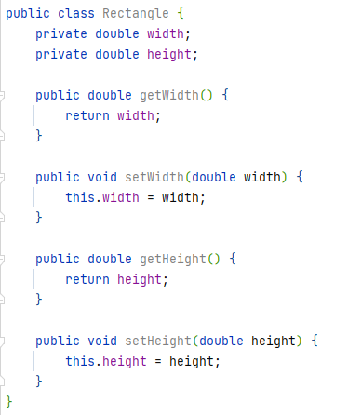
Data Abstraction
Hiding implementation is not just a matter of putting a layer of functions between variables

Slide 4
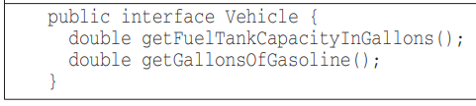
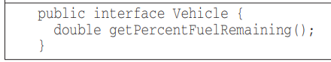
Abstraction
A class should expose abstract interfaces that allow its users to manipulate the “essence” of data without having to know the implementation details
BAD 😒
GOOD 😸

Slide 5
Objects vs. Data Structures
Objects
Hide their data behind abstractions
Expose functions that operate on data
Data Structures
Expose their data
Have no meaningful functions

Slide 6
Exercise
Download and open “In-class Exercise Week 3” codebase
  Follow instructions in zNotes.txt

Slide 7
Objects (OOP) vs. Data Structures (Procedural)
Object Oriented Code
Easy to add new classes without changing existing functions
Hard to add new functions because all the classes must change
Procedural Code (Using Data Structures)
Easy to add functions without changing existing data structures
Hard to add new data structures because all the functions must change
Things that are hard for OO are easy for procedures
Things that are hard for procedures are easy for OO

Slide 8
Objects (OOP) vs. Data Structures (Procedural)
Not everything is an object!
Sometimes you really do want simple data structures with procedures operating on them.
Know whether you need protection from functions or types, do not create hybrid “object/data-structure”s

Slide 9
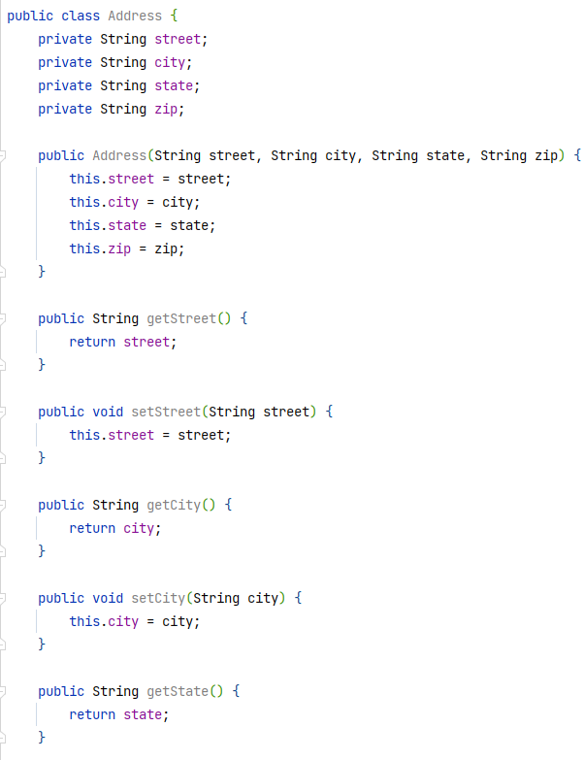
Data Transfer Objects
Perfect example of data structures
Class with public variables and no functions
  Just to stay consistent with OO we use getter and setter functions with private variables, but they don’t provide any benefit
Used when:
  Communicating with DBs
  Parsing messages from external systems HTTP messages, Socket messages etc.

Slide 10
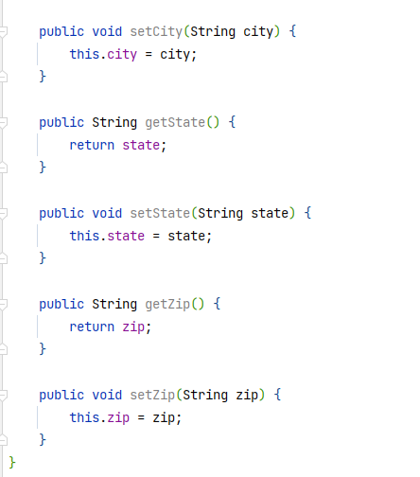
Data Transfer Objects

Slide 11
Active Record
Special form of DTOs
Direct translations from database tables or other sources
  Ex: JPA Entity per table
Have navigational methods such as:
  save()
  find()
These are data structures and should not be treated as objects by putting business rules/methods inside them. This will lead to hybrids.

Slide 12
6.
Error Handling
Ref: Clean Code – Robert C. Martin
Chapter 7

Slide 13
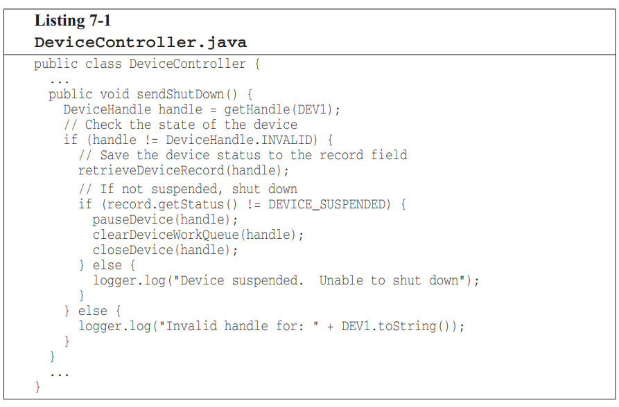
Don’t use Return Codes
Older programming languages did not have support for exceptions
  You either had to set an error flag or return an error code that the caller has to check

Slide 14
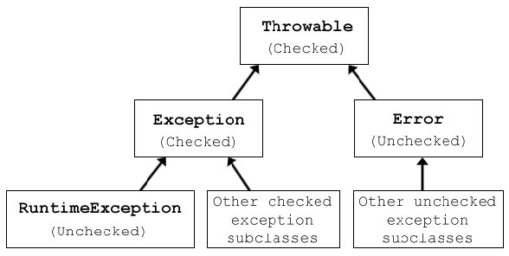
Exceptions in Java

Slide 15
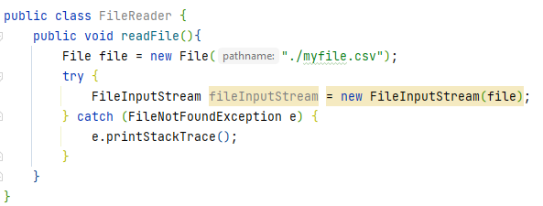
Checked vs. Unchecked Exceptions
Checked Exceptions
MUST be declared in throws clause of a method
Checked during compile time
  If callee throws, caller MUST catch
Ex: FileNotFoundException
Unchecked Exceptions
Is not declared in throws clause
You are not forced to handle them
Not checked at compile time
Ex: NullPointerException

Slide 16
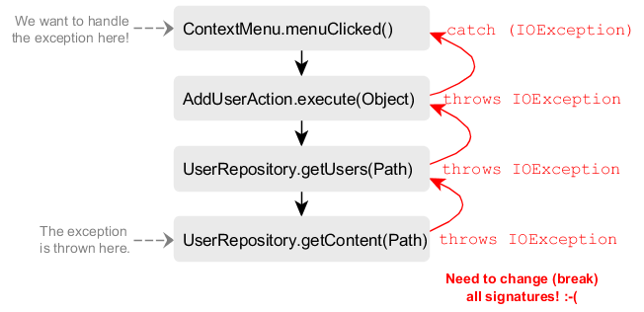
Exception Handling Best Practices
1. Use Unchecked Exceptions
Several robust languages do not have checked exceptions
  Ex: C#, Python, Ruby
Functions at the lowest levels impact functions at the highest levels when checked exceptions are used

Slide 17
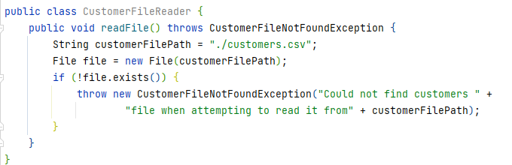
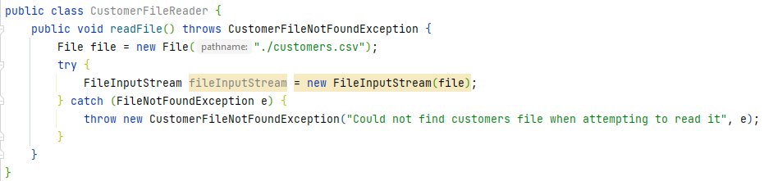
Exception Handling Best Practices
2. Use Custom Exceptions
Either directly throw a custom exception
Or wrap the original exception inside a custom exception and throw it

Slide 18
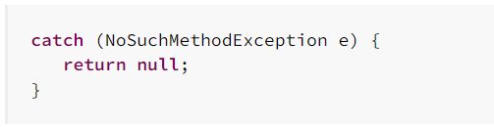
Exception Handling Best Practices
3. Never swallow exceptions in catch block
Cause of error will be lost forever

Slide 19
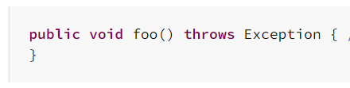
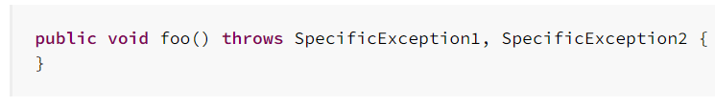
Exception Handling Best Practices
4. Throw specific exceptions
If there are too many specific exceptions to throw, the code needs some refactoring
BAD 😒
GOOD 😸

Slide 20
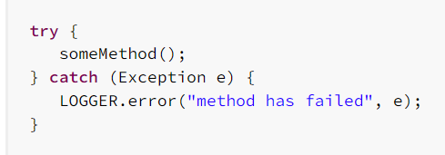
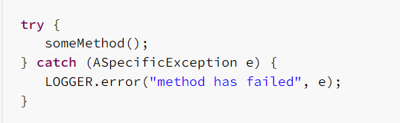
Exception Handling Best Practices
5. Catch specific exceptions
Do not catch the general “Exception” class
BAD 😒
GOOD 😸

Slide 21
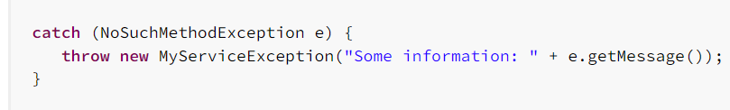
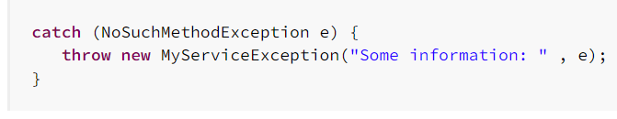
Exception Handling Best Practices
6. Don’t lose the StackTrace
When throwing custom exceptions, make sure to log the original exception inside the custom exception.
BAD 😒
GOOD 😸

Slide 22
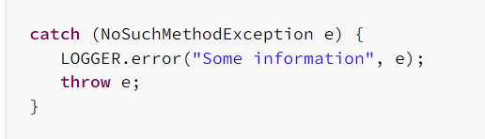
Exception Handling Best Practices
7. Log the exception or throw it, never do both
We don’t want multiple logs of the same problem in the code
BAD 😒

Slide 23
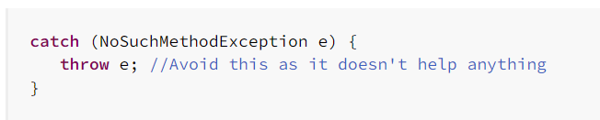
Exception Handling Best Practices
8. Catch only what you can handle
It does no good to catch and rethrow without doing anything
Catch only if you want to add additional context/information to the exception
We only add noise to the code with a try-catch block when we catch and do nothing
BAD 😒

Slide 24
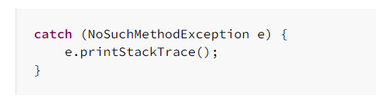
Exception Handling Best Practices
9. Don’t use print stack trace
Message will only be written to the standard output and can be lost
Either log the error or throw it to the caller who can decide what to do with it
BAD 😒

Slide 25
Exception Handling Best Practices
10. Exceptions should not be used for flow of control
The normal course of operation should not raise exceptions
If exceptions are used for normal situations, how do you identify exceptional/unusual situations?

Slide 26
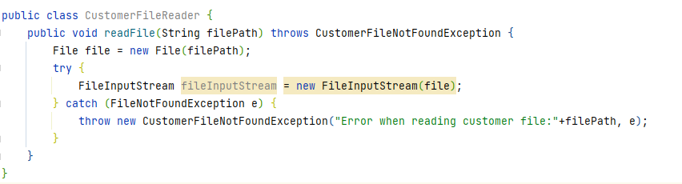
Exception Handling Best Practices
11. Provide context with exceptions
When logging or rethrowing, add contextual information to exceptions
Ex: filePath information added to exception being thrown

Slide 27
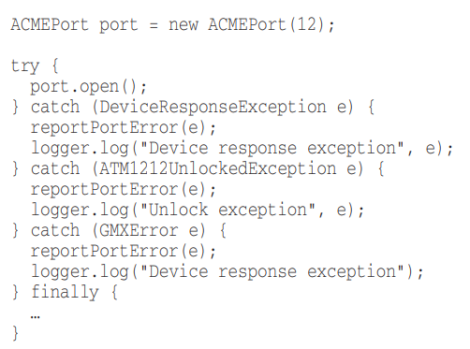
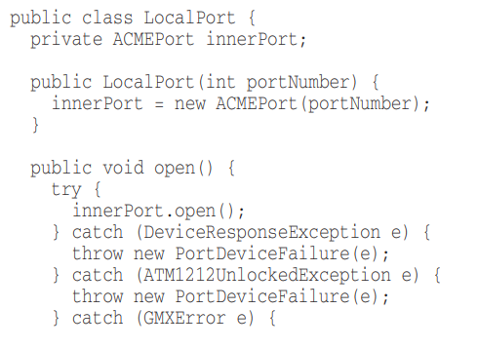
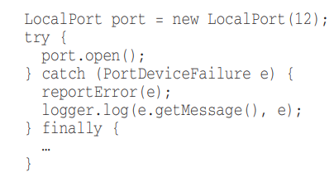
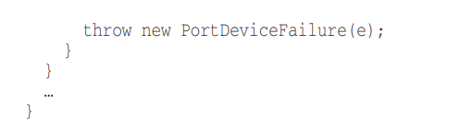
Exception Handling Best Practices
12. Cater to the caller’s needs
Think “How will this exception be caught?” “How will it be handled?”
A lot of times our course of action is the same regardless of the specific exception being thrown

Slide 28
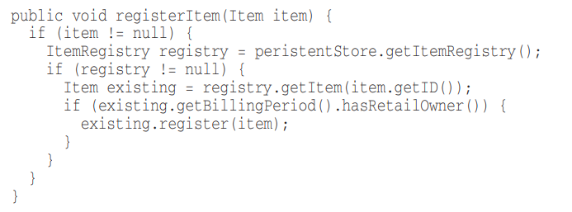
Don’t Return Null
Every other line in the caller’s code becomes a null check
Throw (unchecked) exceptions instead
Use the SPECIAL CASE design pattern (Null object pattern)

Slide 29
Don’t Pass Null
Returning null is bad but passing null is worse
Unless you are working with an API which expects you to pass null, you should avoid passing null
Perform null checks and validation at the external-most parts of the application
  Ex: REST API endpoint (controller), REST API Client (when calling other REST API endpoints)

Slide 30
Logging Best Practices
1. Log at the proper level
FATAL | Signals very bad news, potential application crash
ERROR | Something has gone terribly wrong; we must investigate immediately. Ex: Database unavailability etc.
WARN | Application can tolerate the issue, but issue should be justified or investigated
INFO | Informational messages that highlight the progress of the application at coarse-grained level.
DEBUG | Used to debug an application. For fine-grained information events. Normally turned off on production application.
TRACE | Even more detail added to debug logs

Slide 31
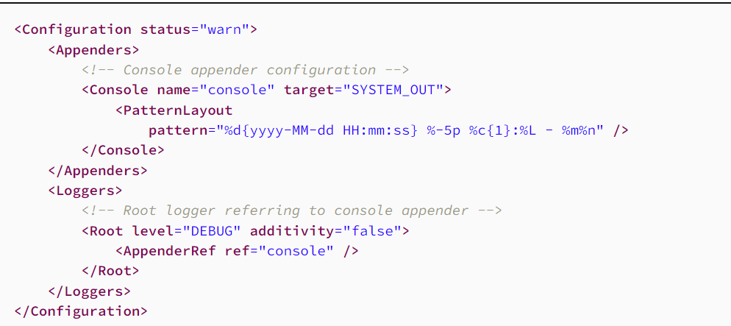
Logging Best Practices
1. Log at the proper level

Slide 32
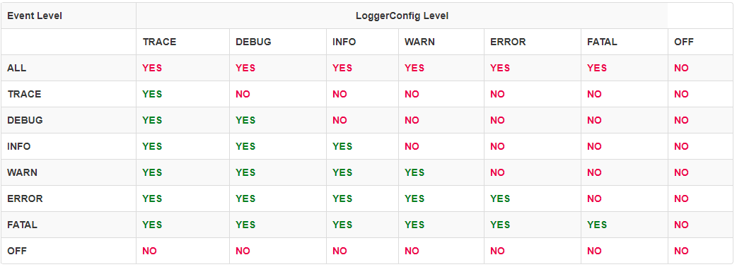
Logging Best Practices
1. Log at the proper level

Slide 33
Logging Best Practices
2. Do not depend on a specific logging library
In Java, the code should depend on a logging framework such as SLF4J API which allows for the underlying logging library to be switched at any time (by changing the dependency)
  Ex: Switch from Log4j to LogBack

Slide 34
Logging Best Practices
Add Context to Log messages (similar to exceptions)
Make logs human readable and machine parse-able
Do not log sensitive information (passwords, tokens etc.)
Define which events to log
  Ex: Validation failures, session management failures,

Slide 35
Exercise
Get an old code base of yours (Java)
Find a minimum of 5 clean code principles violations
  What is the violation?
  Why is the principle important?
  What is the suggested fix?

Slide 36

Free templates for all your presentation needs
For PowerPoint and Google Slides
100% free for personal or commercial use
Ready to use, professional and customizable
Blow your audience away with attractive visuals

Slide 37

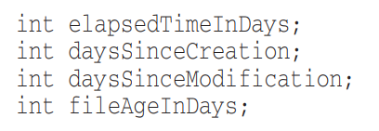
Use Intention Revealing Names
Choosing good names takes time but saves more than it takes
Name should answer all the big questions: Why, What, How
If a name requires a comment, then the intent is not revealed
BAD 😒
GOOD 😸

Slide 38
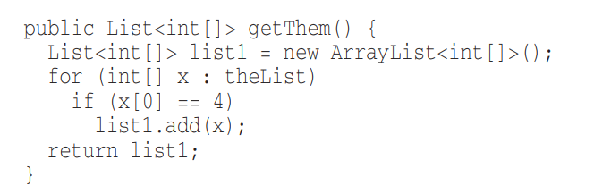
Use Intention Revealing Names Contd.
What is the purpose of this code?
😒

Slide 39
Use Intention Revealing Names Contd.
What is the purpose of this code?
😒
What kind of things are in the list?
What is the significance of the first element in the list?
What is the significance of the value 4?
How do we use the list being returned?

Slide 40
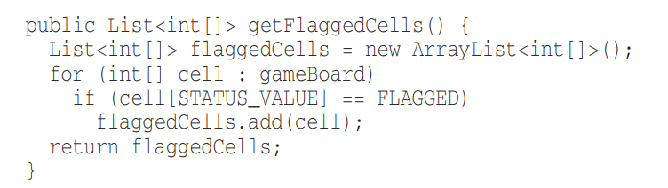
Use Intention Revealing Names Contd.
The code is for a minesweeper game, here’s an improved version
😏
What kind of things are in the list? It represents the game board
What is the significance of the first element in the list? It is the location of a status value
What is the significance of the value 4? Status == Flagged
How do we use the list being returned? It is a list of flagged cells

Slide 41
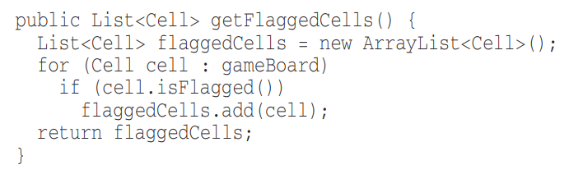
Use Intention Revealing Names Contd.
Improving it further
😸
Class introduced for Cell
isFlagged function used to hide magic numbers

Slide 42


Avoid Disinformation
Don’t make others lead to false conclusions about your code
BAD 😒
GOOD 😸

Slide 43
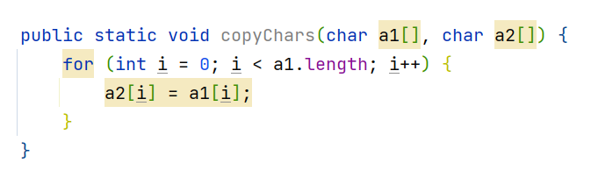
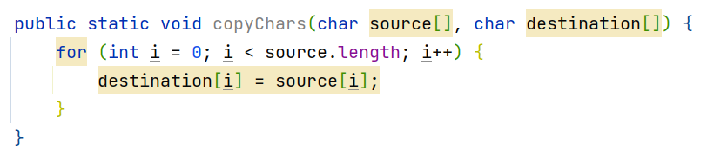
Make Meaningful Distinctions
Ex: number series naming
  Noninformative
  Provide no clue to the reader
BAD 😒
GOOD 😸

Slide 44
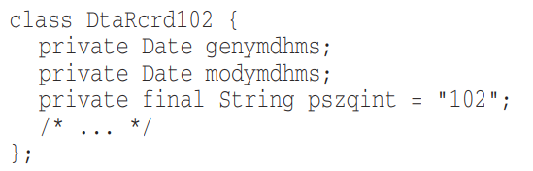
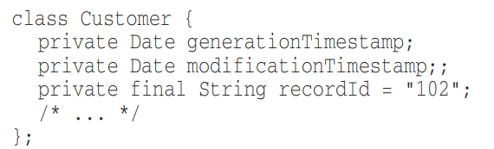
Use Pronouncable Names
“genymdhms” – can you pronounce this?
  generation date, year, month, day, hour, minute, and second)
BAD 😒
GOOD 😸

Slide 45
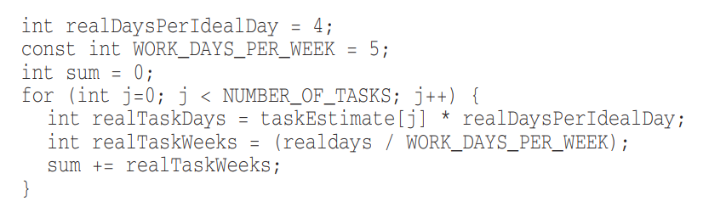
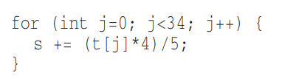
Use Searchable Names
Single letter names should only be used as local variables inside very small methods
  Length of the name should correspond to the size of the scope
If a variable might be used in multiple places in a body of code, you must give it a searchable name
BAD 😒
GOOD 😸

Slide 46


Avoid Encodings – Hungarian Notation
This was used when there were limitations in type checking and strong typing
BAD 😒
GOOD 😸

Slide 47
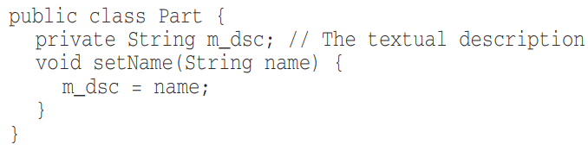
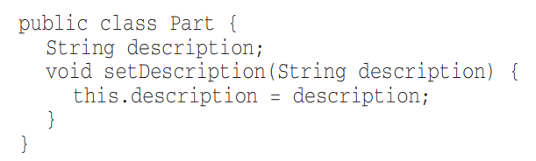
Avoid Encodings – Member Prefixes
You don’t need to prefix member or instance variables with “m_”
BAD 😒
GOOD 😸

Slide 48
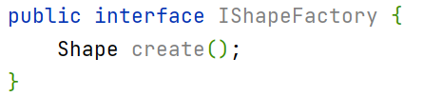
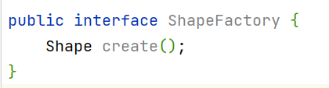

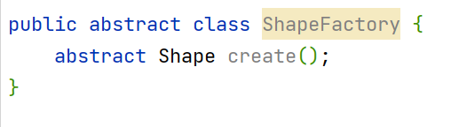
Avoid Encodings – Interfaces and Implementations
Users don’t need to know whether they are using an interface or abstract class
BAD 😒
GOOD 😸

Slide 49
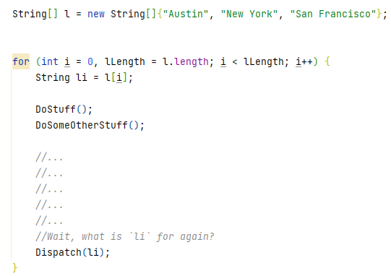
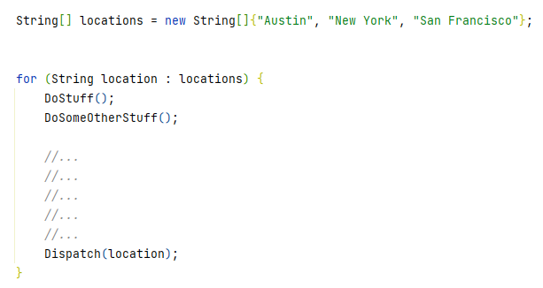
Avoid Mental Mappings
Readers shouldn’t have to mentally translate your names into other names
BAD 😒
GOOD 😸

Slide 50
Class Names
Classes and objects should have Noun or Noun phrase Names
SHOULD NOT BE A VERB
BAD 😒
GOOD 😸
Manager
Processor
Data
Info
Customer
Account
Address
AddressParser

Slide 51
Method Names
Methods should have Verb or Verb phrase Names
BAD 😒
GOOD 😸
customer.name(“John”);
report.data();
supplier.postPayment(address);
report.save();
customer.getName();
customer.setName(“John”);

Slide 52
One word per concept
Ex: it’s confusing to have fetch, retrieve, and get as equivalent methods of different classes
BAD 😒
GOOD 😸
monthlyReport.getCustomers();
monthlyReport.fetchLoyalCustomers();
monthlyReport.retreiveSuppliers();
monthlyReport.getCustomers();
monthlyReport.getLoyalCustomers();
monthlyReport.getSuppliers();

Slide 53
Use Solution Domain Names
Readers are also programmers
Use Computer Science terms in code
  BubbleSort, AccountVisitor, JobQueue
Use Problem Domain Names
When you don’t have words from the solution domain, use names from the problem domain

Slide 54
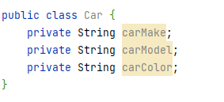
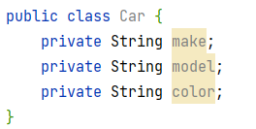
Don’t Add Unncessary Context
Add no more context to a name than necessary
  Shorter names are generally better than larger ones
BAD 😒
GOOD 😸

Slide 55
2.
Functions
Ref: Clean Code – Robert C. Martin
Chapter 3

Slide 56
SMALL!!
Rule 1: Functions Should be Small!
Rule 2: They should be smaller than that!!

Slide 57
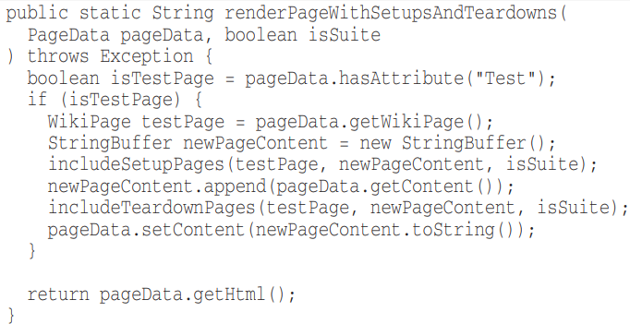
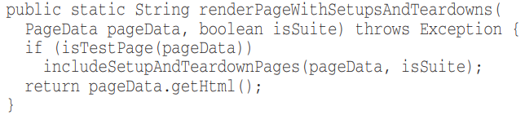
Blocks and Indenting
Keep code within if, else, while etc. blocks to one line
NOT THE BEST😒
GOOD 😸

Slide 58
FUNCTIONS SHOULD DO ONE THING. THEY SHOULD DO IT WELL.
THEY SHOULD DO IT ONLY.

Slide 59

One Level of Abstraction per Function
Concepts at a higher level of abstraction should not be mixed with concepts at a lower level of abstraction
Follow the step-down rule

Slide 60
Use Descriptive Names
Long descriptive names are better than short confusing names
Spend time to choose a good name.
  Try several different names and read the code
Be consistent with names
Name should answer all the big questions: Why, What, How
If a name requires a comment, then the intent is not revealed

Slide 61
Function Arguments/Parameters
Ideally zero parameters (Niladic)
Next, one parameter (Monadic)
Next, two parameters (Dyadic)
Next, three parameters (Triadic) – Try to avoid where possible
More than three (Polyadic) – Must Avoid or atleast have a good justification

Slide 62

Function Arguments/Parameters
When more than two or three arguments are required, the arguments can be wrapped into a class of their own.

Slide 63

Have No Side Effects
Function promises to do one thing, but it also does other hidden things.

Slide 64
Command Query Separation
Functions should either do something or answer something but not both.

Slide 65
3.
Comments
Ref: Clean Code – Robert C. Martin
Chapter 4

Slide 66
Comments do not make up for bad code!

Slide 67


Explain yourself in code
Which would you rather see?
BAD 😒
GOOD 😸

Slide 68



Informative Comments
Use the name of the function to convey information where possible
BAD 😒
GOOD 😸

Slide 69


Explanation of Intent
Use comments to communicate decisions that were made

Slide 70

TODO
TODOs can be used to indicate work left for later
  Must be regularly cleaned and reduced

Slide 71

Amplification
Use comments to amplify the importance of something

Slide 72
If you decide to write a comment, then spend the time necessary to make sure it is the best comment you can write

Slide 73

Redundant Comments
Reading the code itself might be faster than reading redundant/repetitive comments

Slide 74

Mandated Comments
Not every function/param needs to have a Javadoc

Slide 75
4.
Formatting
Ref: Clean Code – Robert C. Martin
Chapter 4

Slide 76
Vertical Formatting
Try to maintain an upper limit of 500 lines per file
Should read like a newspaper
  First paragraph gives a synopsis
  As you go down, details are revealed

Slide 77


Vertical Openness between concepts
BAD 😒
GOOD 😸

Slide 78
Vertical Distance
Variables should be declared as close to their usage as possible
Instance variables, should be declared at the top of the class
If one function calls another, they should be vertically close, and the caller should be above the callee, if at all possible
  https://plugins.jetbrains.com/plugin/11005-clean-code-method-rearranger

Slide 79
Horizontal Formatting
Prefer short lines
  Prefer Max 80 characters per line

Slide 80


Indentation
Avoid collapsing scopes to one line
BAD 😒
GOOD 😸

